Slide 1

IMPLEMETATION OF REINFORCEMENT LEARNING ON SNAKE GAME
INTRODUCTION TO ARTIFICIAL INTELLIGENCE
TEAM MEMBERS:
SHASHANK MADIPELLY
SANTHI SWARUP YALAPALLI
VEDANTH DODDANNAGARI

Slide 2
IMPLEMENTAION OF A REINFORCEMENT LEARNING AGENT ON A SNAKE GAME
PROJECT OBJECTIVE :
The main objective is to create a snake agent using reinforcement learning technique which can able to play snake game itself by learning and updating itself every time.
And Another objective is to make our agent intelligent or get it trained efficiently within less number of game.
Here, The goal is to create a Reinforcement Learning agent to make an optimal decision in the closed environment to get the highest reward.
In this environment, it has incomplete information, and the state space of agents are quite large, We need to deal with these hurdles.
Evaluate our agent based on number of games played and agent scored.

Slide 3
APPROACH:
We will develop a snake game environment using Pytorch & Pygame libraries.
Implement reinforcement learning algorithms: We will implement the following reinforcement learning algorithms in Python using the PyTorch library:
Q-learning
Deep Q-learning
Training process breakdown
State representation
Action selection
Reward system
Exploration strategy

Slide 4
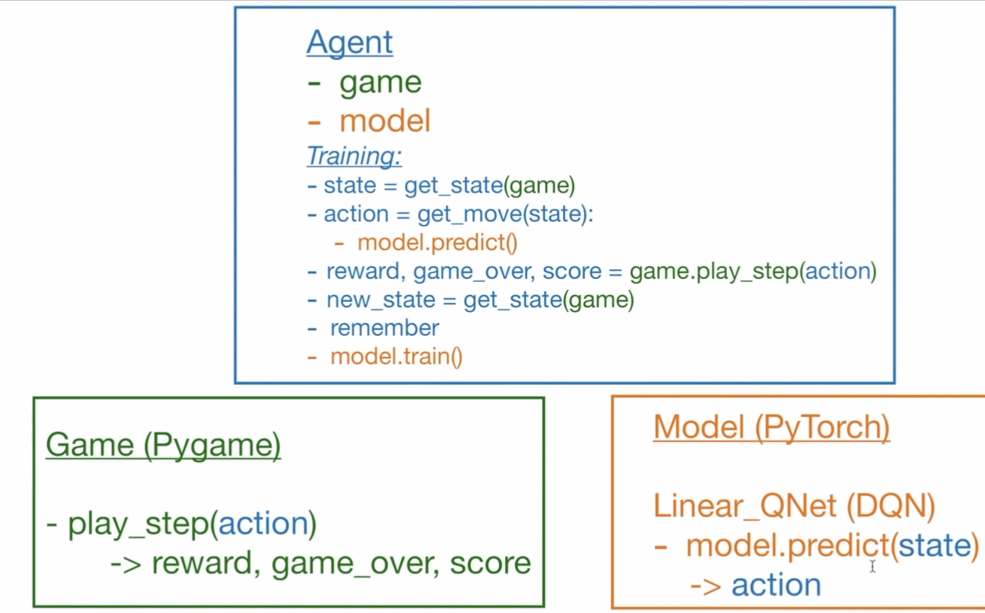

Slide 5
DELIVERABLES:
Documentation manual mentioning about game implementation about various models.
Presentation on project overview.
YouTube link demonstrating the game implementation
The project will be submitted as a GitHub repository containing the following files.
Snake game environment code
Reinforcement learning algorithm code
Trained snake AI agent code
Evaluation report

Slide 6
EVALUATION METHODOLOGY:
The snake game environment will be evaluated by ensuring that it provides the snake AI agent with the correct game state and allows it to take valid actions.
Metrics for evaluating the performance of the RL agent
Average score over multiple runs
Learning curve
Exploration-exploitation trade-off analysis

Slide 7
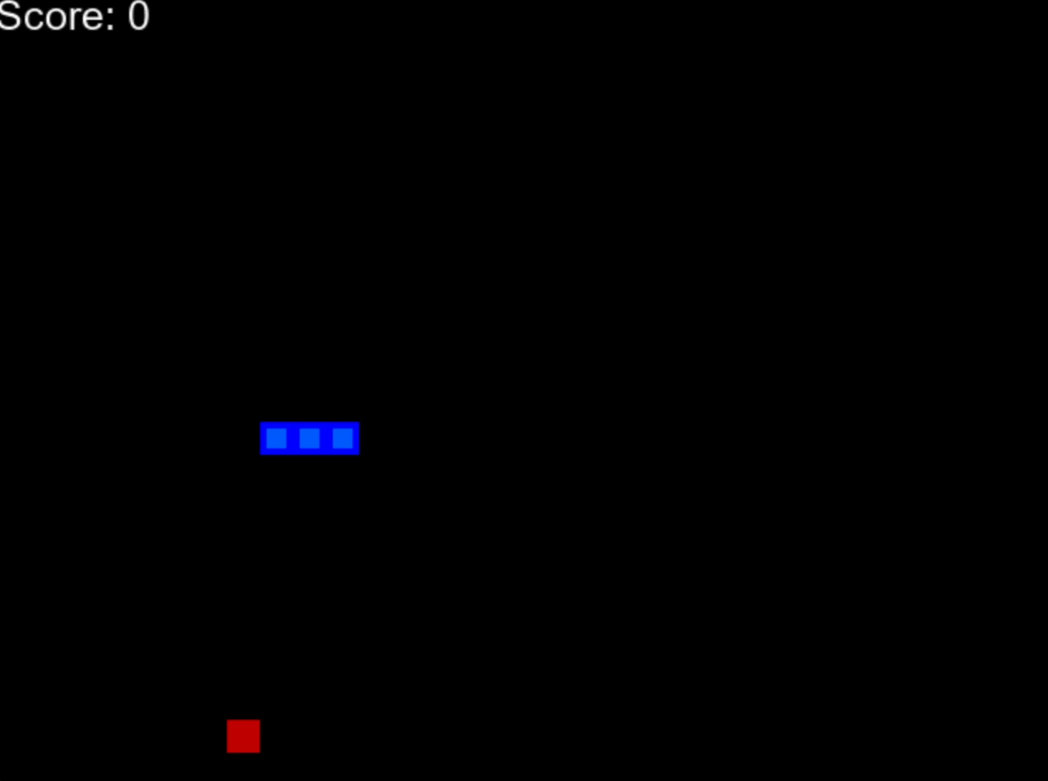
SNAKE GAME SAMPLE DEPLOYMENT

Slide 8
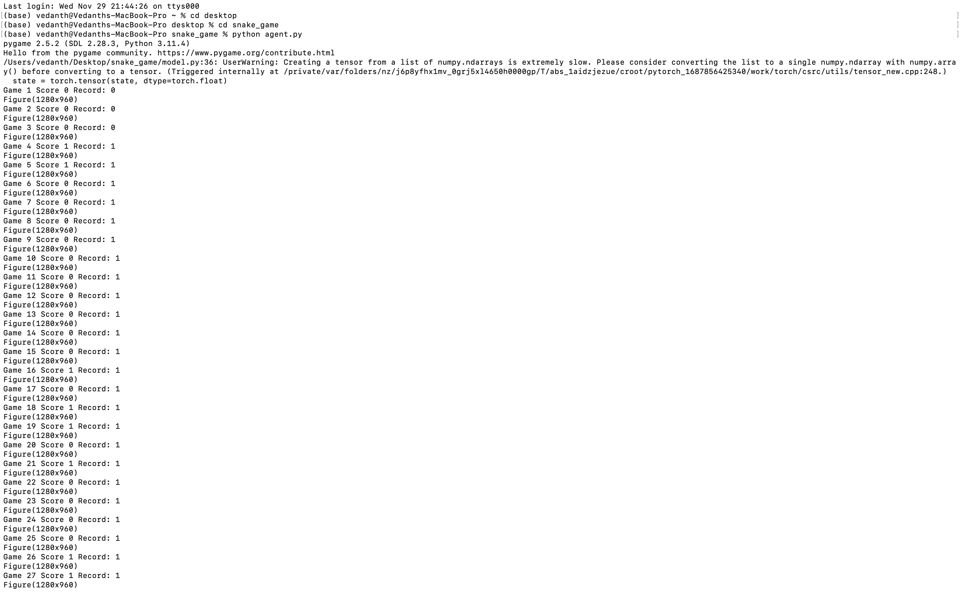
RESULTS

Slide 9
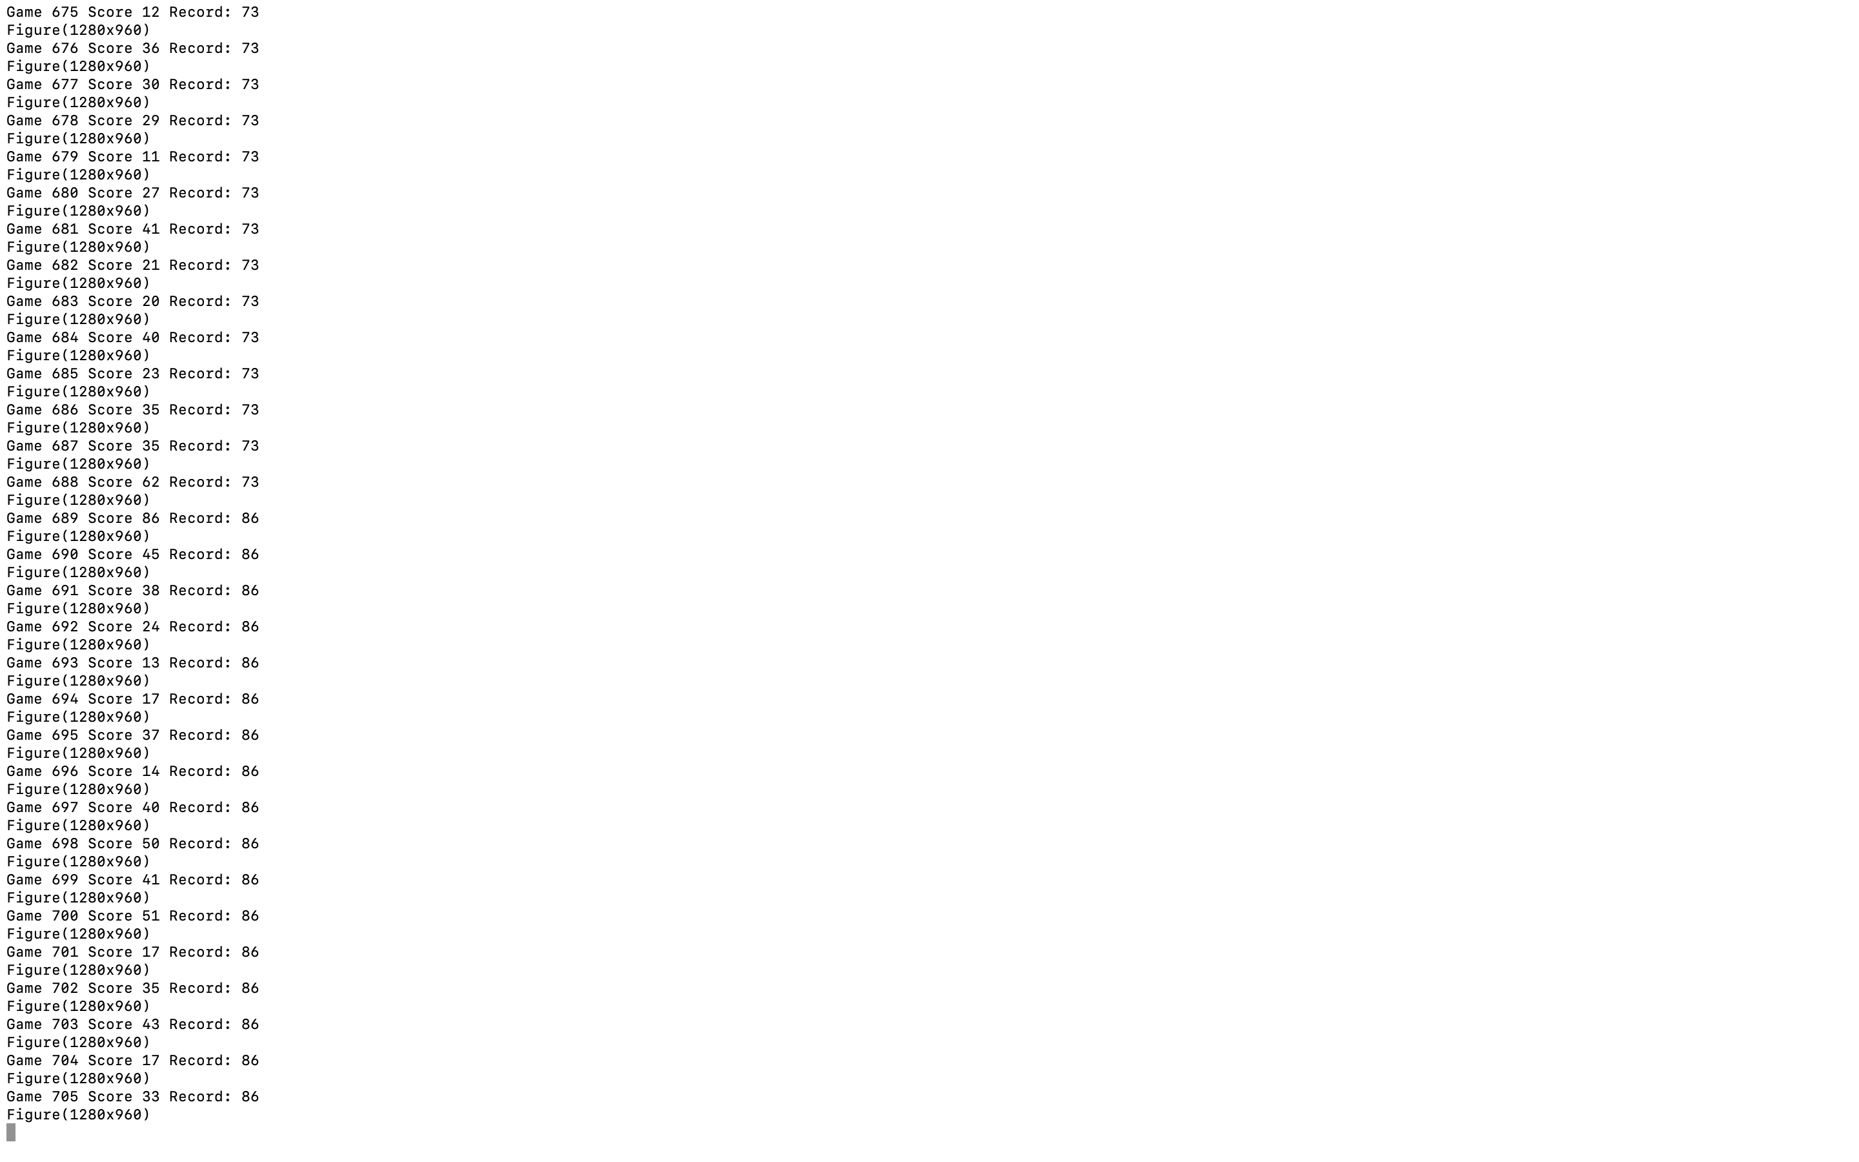

Slide 10
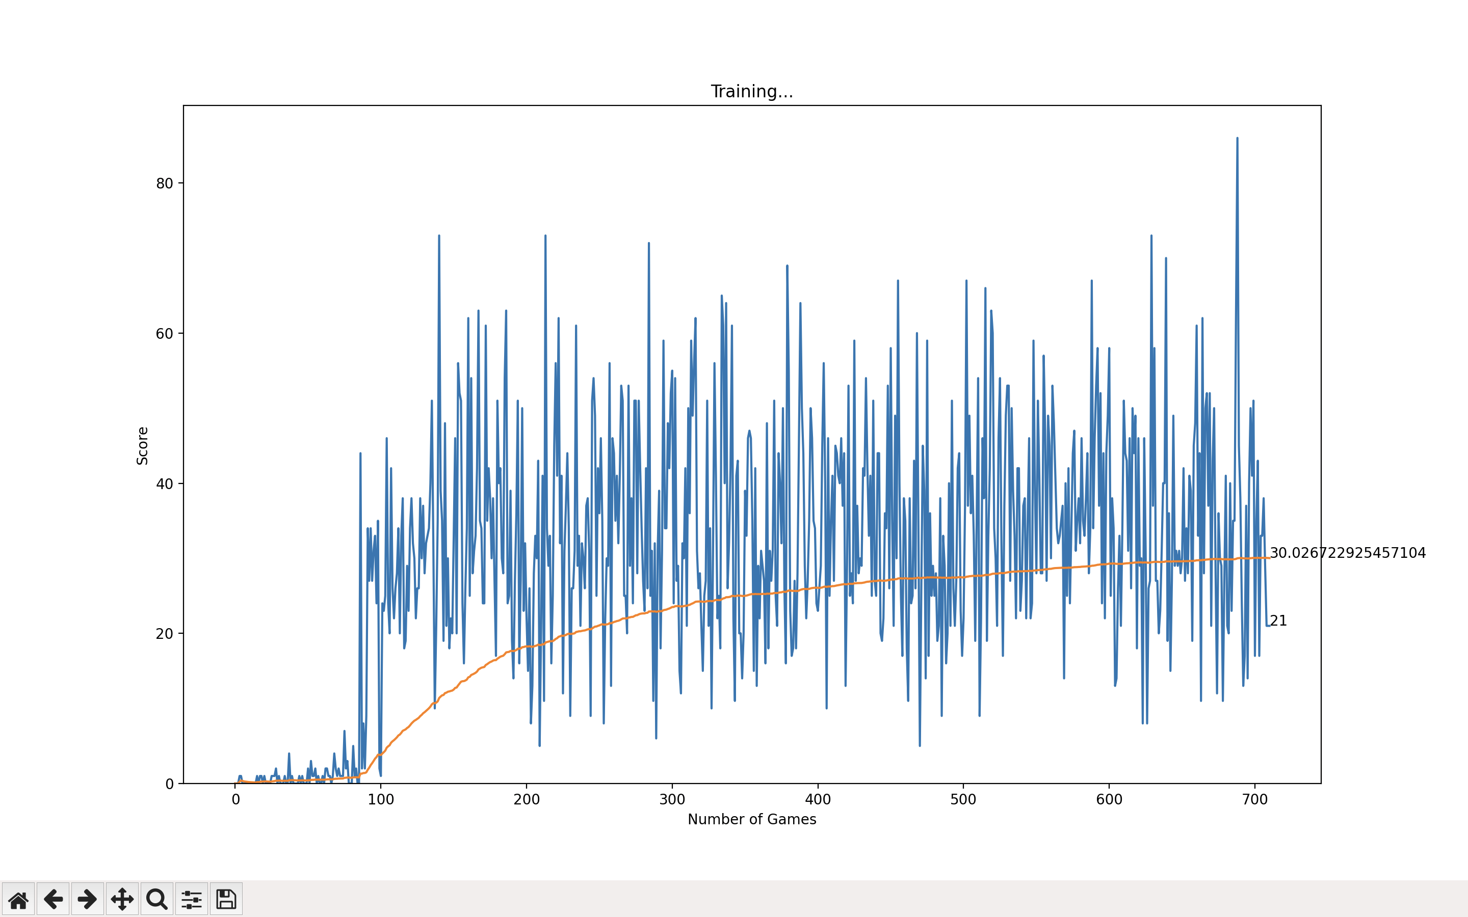

Slide 11
CONCLUSION
Based on the parameter values we have chosen. We found to see how the agent would perform over a 700 games compared with the default values we have taken. These experiments are conducted to find the optimal values to make our RL agent more efficient than that of default values.
Learning rate, epsilon and gamma parameters had the biggest impact on the performance.
The other parameters like food distance, direction and food generation were detrimental to the experiment.

Slide 12
Thank you

